Slide 1
AI & DATA SCIENCE TRACK • FINAL GRADUATION PROJECT
Sales Forecasting &
Demand Prediction
PROJECT SNAPSHOT
0.94
R²
Holdout fit quality
331.61
AI-powered retail demand intelligence for inventory, staffing, and supply-chain decisions.
RMSE
Avg unit-sales error
54
STORES
Ecuador-wide coverage
TRACK
DATASET
DATE
33
AI & Data Science
Kaggle Favorita — 3M+ rows
July 2026
FAMILIES
Product categories
SUBMITTED BY
⚡
XGBoost · FastAPI · Streamlit · MLflow
Data Science Capstone Team

Slide 2
PRESENTATION ROADMAP
From business problem to deployed forecasting system
A guided walkthrough — problem → data → insights → features → models → operations → value
01
02
03
04
The Business Problem
Data Foundation
Exploratory Analysis
Feature Engineering
Why forecasting matters, operational cost of poor prediction, scope.
Source, structure, cleaning pipeline, merge logic.
Sales trends, seasonality, holiday effects, external drivers.
Time, holiday, external signals, importance ranking.
05
06
07
NARRATIVE ARC
A connected story, not seven silos
Predictive Modeling
MLOps & Deployment
Business Impact & Future
Each chapter answers a question the previous one raised.
Model selection, time-aware validation, comparison, winner.
Monitoring, drift detection, API, dashboard, retraining.
Operational value, ROI, challenges, next steps.
?
PROBLEM
›
▦
DATA
›
◆
INSIGHTS
›
⚙
FEATURES
›
⊟
MODELS
›
➤
OPERATIONS
›
↗
VALUE
Sales Forecasting & Demand Prediction
Agenda · 2 / 40

Slide 3
01
CHAPTER ONE
The Business
Problem
OPERATIONAL DECISIONS
▣
Inventory
Stock levels per store-product-day
Why accurate sales forecasting is the backbone of retail operations.
↻
Replenishment
Restock timing and quantity
♟
Staffing
Workforce scheduling by demand
◖
Marketing
Campaign timing and targeting
⊟
Supply Chain
Procurement and logistics visibility
Forecasting is not about predicting numbers — it is about making better operational decisions.
SECTION 01 OF 07

Slide 4
CHAPTER 01 · THE BUSINESS PROBLEM
Why forecasting matters
INDUSTRY CONTEXT
Why Forecasting Matters
Forecasting is the operational backbone of retail — and weak forecasting cascades across every function.
4%
5 Operational Decisions Driven by Forecasting
Where accurate forecasts create measurable value
of annual retail revenue lost to stockouts alone
▣
↻
Inventory Planning
Replenishment
CASCADING COST OF POOR FORECASTING
Optimal stock levels per store-product combination.
Timing and quantity for restocks.
⚠
Stockouts → immediate lost sales and customer churn
♟
◖
⚠
Overstocking → working capital trapped, increased waste
Staffing
Marketing Timing
⚠
Staffing mismatch → overtime cost or poor service
Workforce scheduling by predicted demand.
Campaign scheduling for maximum impact.
⚠
Marketing mistimed → missed revenue windows
⊟
Supply Chain Visibility
⚠
Supply chain blind → no procurement visibility
End-to-end demand signals for procurement and logistics.
⚑
Project scope: an ML-powered forecasting system using historical retail data from 54 stores and 33 product families in Ecuador, enriched with external economic and calendar signals.
Sales Forecasting & Demand Prediction
4 / 40

Slide 5
02
CHAPTER TWO
Data
Foundation
SOURCE FILES
▦
train.csv
3,000,888 rows
Understanding the dataset, its structure, and the signals it carries.
🏪
stores.csv
54 rows
▦
holidays_events.csv
350 rows
◐
oil.csv
1,218 rows
✦
transactions.csv
83,536 rows
The quality of any ML model is fundamentally limited by the quality of its data.
SECTION 02 OF 07

Slide 6
CHAPTER 02 · DATA FOUNDATION
Dataset overview & source
CORPORACIÓN FAVORITA · ECUADOR
Dataset Overview & Source
A real-world retail dataset from Corporación Favorita (Ecuador) — five source files, one unified time-series.
SOURCE FILES
DATASET SCOPE
ENRICHMENT
Source Files & Record Counts
Coverage at a Glance
External Signal Layers
▦
train.csv
Oil Prices
3,000,888 rows
54
33
◐
Economic conditions proxy for oil-dependent Ecuador.
🏪
stores.csv
54 rows
STORES
PRODUCT FAMILIES
Holidays
▦
National, regional, local levels + events.
▦
holidays_events.csv
350 rows
◐
oil.csv
22
2013–2017
⌧
Promotions
1,218 rows
On-promotion flag per store-product-day.
▤
transactions.csv
CITIES
TIME PERIOD · 5 YRS
83,536 rows
✦
Transactions
A multi-year, multi-store, multi-category retail panel — dense enough to expose trend, seasonality, and store-family heterogeneity.
Store traffic volume as demand proxy.
ⓘ
Target variable: daily unit sales per (store, product_family, date) — 1,782 store-family pairs forecast simultaneously.
Sales Forecasting & Demand Prediction
6 / 40

Slide 7
CHAPTER 02 · DATA FOUNDATION
Data preparation pipeline
PIPELINE
Data Preparation Pipeline
A four-step cleaning pipeline that preserves time-series integrity while merging five source files.
1
▦
2
✦
3
✚
4
✓
Date Parsing & Standardization
›
Multi-File Merge Logic
›
Missing Value Handling
›
Quality Assurance
Unified date formats (parse_dates) across all 5 source files for consistent merging on date and store keys.
Left-join train with stores, holidays_events, oil, and transactions on date + store keys. Preserves every train row, enriches with external signals.
Oil: forward-fill then back-fill (time-ordered). Transactions: store-family median imputation. Categoricals: Unknown fill.
Zero duplicates found. Transferred holidays excluded. Outliers winsorized at 99.5th percentile to limit extreme tails without erasing signal.
OUTPUT
FINAL DATASET
Cleaning Summary
Ready for Modeling
✓
5 source files merged into unified time-series dataframe.
3M+
20
✓
Date parsing standardized across all sources.
ROWS
FEATURES
✓
Missing values handled per-column with time-aware strategy.
→
Final shape: 3,000,888 × 22 columns
✓
Zero duplicate (store, family, date) keys after dedup.
→
Saved as clean_store_sales.csv
✓
Outliers winsorized at 99.5th percentile.
→
Reproducible artifact · version-pinned
Sales Forecasting & Demand Prediction
7 / 40

Slide 8
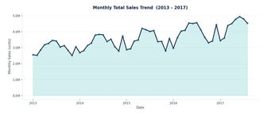
03
CHAPTER THREE
Exploratory
Analysis
DAILY SALES · 2013–2017
What the data reveals about sales patterns, seasonality, and external drivers.
+8%
Dec ↑
Sat ↑
YOY GROWTH
Q4 PEAK
WEEKEND LIFT
EDA is not about making pretty charts — it is about discovering the patterns that will inform our feature engineering and model choices.
SECTION 03 OF 07

Slide 9
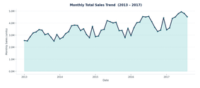
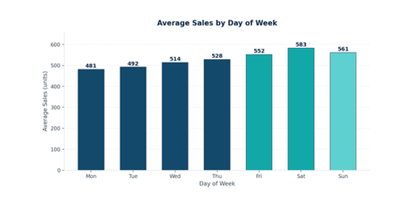
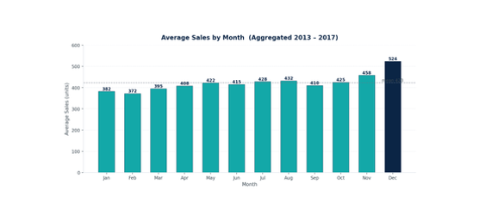
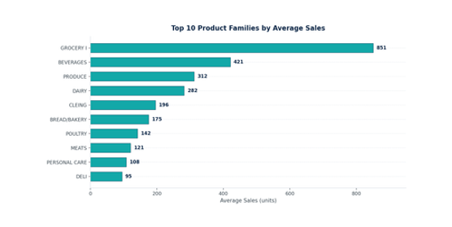
CHAPTER 03 · EXPLORATORY ANALYSIS
Overall sales trend
TREND & PATTERNS
Overall Sales Trend
A clear upward trend with strong weekly seasonality — the data grows ~8% YoY and peaks on weekends.
MONTHLY TOTAL SALES TREND
image-9-1
AVG SALES BY DAY OF WEEK
image-9-2
KEY INSIGHTS
↗
Upward Trend
~8% YoY growth 2013–2017, with seasonal oscillations.
▦
Weekend Uplift
Sat–Sun average ~15% above weekday mean, consistent across years.
▦
Store/Family Skew
Top 5 families = ~60% of total volume; GROCERY I alone = ~20%.
Upward trend with consistent December peaks and seasonal oscillations.
Saturday peaks at ~583 avg units; weekdays average ~497.
AVG SALES BY MONTH
image-9-3
TOP 10 PRODUCT FAMILIES
image-9-4
ENGINEERED
December spikes 25–35% above Q1 baseline — Christmas + year-end demand.
dayofweek · month
weekofyear · year
GROCERY I dominates at 851 avg units, 2× larger than BEVERAGES.
Sales Forecasting & Demand Prediction
9 / 40

Slide 10


CHAPTER 03 · EXPLORATORY ANALYSIS
Seasonality deep dive
SEASONAL DECOMPOSITION
Seasonality Deep Dive
Seasonality is the strongest signal in this dataset — Q4 alone runs 25–35% above Q1 baseline.
QUARTERLY PATTERN (SEASONAL VS TREND)
SEASONALITY METRICS
↗
25–35%
Q4 SALES ABOVE Q1 BASELINE
Christmas + year-end demand drives December peak.
↗
~8%
YEAR-OVER-YEAR GROWTH RATE
Steady underlying trend across 2013–2017.
▦
20–40%
Q4 seasonal index 135 vs Q1 baseline 100 — trend remains steady at ~8% YoY.
HOLIDAY BOOST (GROCERY/BEVERAGE)
Strongest on grocery and beverage categories.
TIME-SERIES DECOMPOSITION (ADDITIVE, PERIOD=365)
$
Payday Effect
SALES SPIKE AROUND 15TH
Recurring monthly bump around mid-month.
WHY THIS MATTERS
The consistent seasonal patterns are what make ML effective here — the model can learn these repeating structures. The December peak and January dip directly drive inventory planning. The payday effect informs staffing decisions.
Trend, seasonal, and residual components extracted via additive decomposition.
Sales Forecasting & Demand Prediction
10 / 40

Slide 11
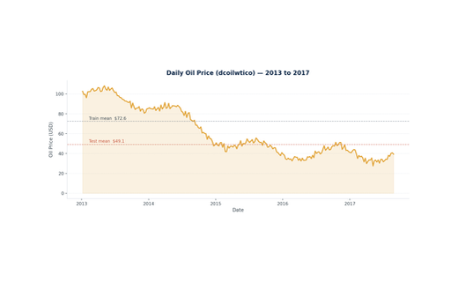
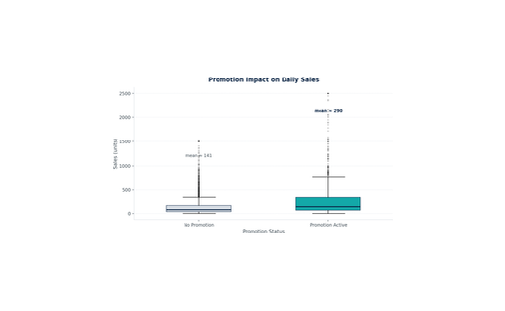
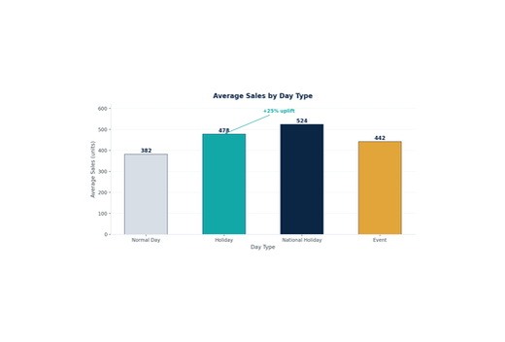

CHAPTER 03 · EXPLORATORY ANALYSIS
External factors impact
OIL · PROMOTIONS · HOLIDAYS
External Factors Impact
Three external signals move sales — oil prices (macro), promotions (micro), and holidays (calendar).
◐
Oil Prices
⌧
Promotions
▦
Holidays
−0.32
CORRELATION
WITH SALES
+25%
AVG SALES UPLIFT
WHEN ACTIVE
3 levels
NATIONAL,
REGIONAL, LOCAL
Ecuador is an oil-dependent economy. Oil price drops signal broader economic stress — lower consumer confidence → lower retail spending. Oil fell from $72.6 (train mean) to $49.1 (test mean).
Strongest effect on GROCERY I and CLEANING. The onpromotion flag is the single most predictive feature in the final XGBoost model — validating the EDA insight at model level.
National holidays have the largest impact. Events (football tournaments) create category-specific spikes in BEVERAGES and PREPARED FOODS.
Combined effect discovery — multiplicative uplift
✦
When promotions coincide with holidays, the sales uplift is multiplicative (40–60%) rather than additive (25% + 15% = 40%). The most actionable insight for marketing teams — timing promotions around holidays compounds the benefit.
Sales Forecasting & Demand Prediction
11 / 40

Slide 12
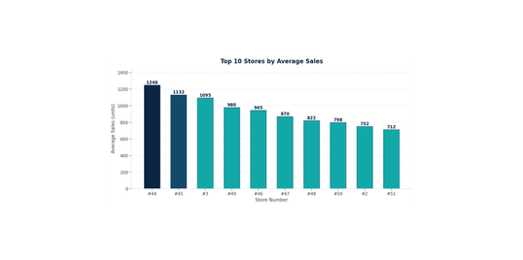
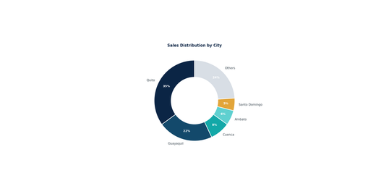
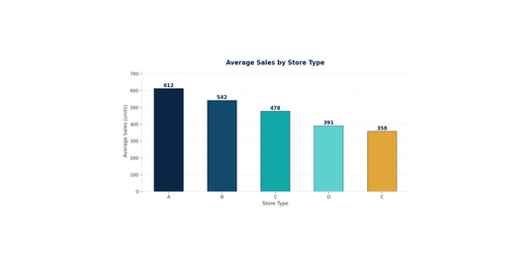
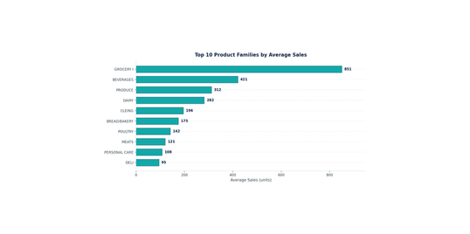
CHAPTER 03 · EXPLORATORY ANALYSIS
Store & geography patterns
SEGMENTATION
Store & Geography Patterns
Volume is highly skewed — top 5 cities drive 70%+ of total sales, and store type A outpaces type E by ~70%.
TOP 10 STORES BY AVERAGE SALES
SALES DISTRIBUTION BY CITY (DONUT)
QUICK INSIGHTS
🏪
Store-level skew
Top 10 stores = ~30% of total volume.
◯
Geographic concentration
2 cities = 57% of sales.
▣
Category concentration
5 families = ~60% of volume.
Store #44 leads at 1,248 avg units — 2.3× the chain-wide mean.
Quito + Guayaquil = 57% of total volume; remaining 20 cities share 43%.
AVERAGE SALES BY STORE TYPE
TOP 10 PRODUCT FAMILIES BY AVG SALES
BUSINESS IMPLICATION
Forecasting accuracy on the top stores/families/cities has disproportionate business value — segment-specific model tuning may be warranted in future iterations.
Type A stores average 612 units vs Type E at 358 — segment-aware forecasting is essential.
GROCERY I, BEVERAGES, PRODUCE, DAIRY, CLEANING = top 5 families by volume.
Sales Forecasting & Demand Prediction
12 / 40

Slide 13
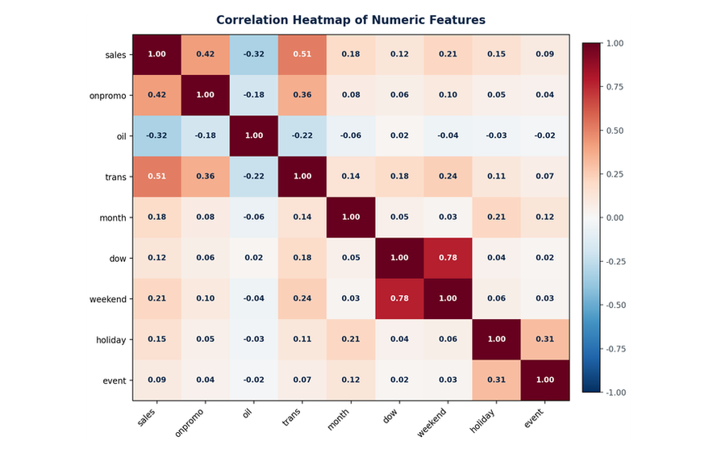
CHAPTER 03 · EXPLORATORY ANALYSIS
Correlation analysis
PEARSON CORRELATION
Correlation Analysis
Correlations confirm three signal families — demand (transactions), promotion (onpromotion), and macro (oil).
PEARSON HEATMAP
9 FEATURES
KEY CORRELATIONS WITH SALES
N = 5
9 Numeric Features
1
transactions ↔ sales
+0.51
STRONG POSITIVE
2
onpromotion ↔ sales
+0.42
MODERATE POSITIVE
3
dcoilwtico ↔ sales
−0.32
MODERATE NEGATIVE
4
is_weekend ↔ sales
+0.21
WEAK POSITIVE
5
is_holiday ↔ sales
+0.15
WEAK POSITIVE
INTERPRETATION
Transactions is the strongest demand signal — but only available historically, not at inference time, which created an inference-time feature gap (discussed in Chapter 7). Oil price has a meaningful negative correlation reflecting Ecuadorian economic dynamics. Promotions and weekend flags provide moderate signal that the model can exploit.
Pearson correlation across 9 numeric features. Red = positive, blue = negative.
Sales Forecasting & Demand Prediction
13 / 40

Slide 14
04
CHAPTER FOUR
Feature
Engineering
20
Transforming raw data into model-ready predictive signals.
FEATURES
4 families
◔
▦
TIME
HOLIDAY
8 features
5 features
◐
🏪
EXTERNAL
STORE META
3 features
4 features
Feature engineering is often more important than model selection — the best model cannot learn from poorly designed features.
SECTION 04 OF 07

Slide 15
CHAPTER 04 · FEATURE ENGINEERING
15
20 FEATURES · 4 FAMILIES
Feature Strategy
20 features across 4 families — each engineered with a business hypothesis, not random.
◔
TIME-BASED
8 FEATURES
▦
HOLIDAY
5 FEATURES
⚙
EXTERNAL SIGNALS
3 FEATURES
🏪
STORE METADATA
4 FEATURES
year — long-term trend
month — seasonal cycle
day — day-of-month effect
dayofweek — weekly pattern
weekofyear — annual position
is_weekend — binary flag
month sin-cos — cyclical encoding
dow sin-cos — cyclical encoding
is_holiday — any holiday
is_national — country-wide
is_regional — state-level
is_local — city-level
is_event — special events
dcoilwtico — oil price proxy
transactions — store traffic volume
onpromotion — promotional intensity
store_nbr — store identity
family — product category
city, state — geography
type, cluster — store segmentation
Note: Created but excluded: month_sin, month_cos, dow_sin, dow_cos — retained as future option if model needs explicit cyclical signal.
Note: Geographic precision: a holiday in Quito does not affect Guayaquil predictions. Transferred holidays excluded.
Note: These capture the external environment that pure time-series models miss.
Note: Categorical features captured via OneHotEncoder in the pipeline.
✕
FEATURES CONSIDERED BUT EXCLUDED
3 features · leakage-aware engineering — lag features were created and tested but excluded from the final model to prevent target leakage at inference time.
Sales Forecasting · Demand Prediction
15 / 40

Slide 16
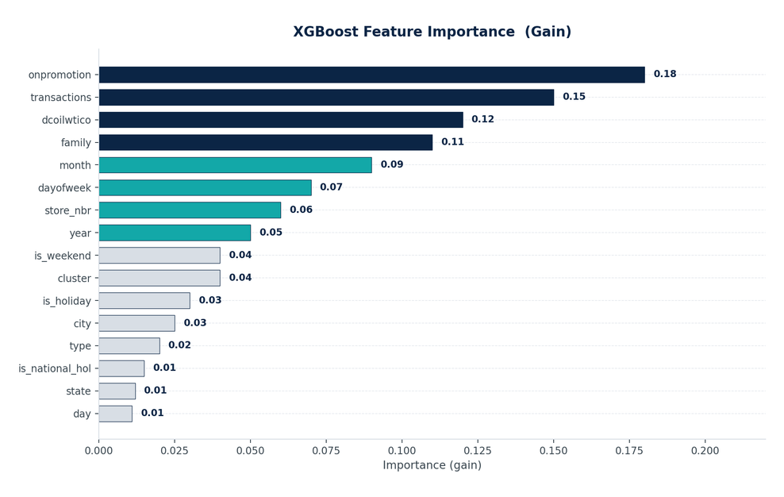
CHAPTER 04 · FEATURE ENGINEERING
16
XGBOOST GAIN IMPORTANCE
Feature Importance
XGBoost feature importance validates EDA — promotions dominate, store traffic is second, oil captures macro.
XGBOOST FEATURE IMPORTANCE (GAIN)
≥0.10
≥0.05
<0.05
TOP 5 INSIGHTS
RANKED
1
PROMOTIONS DOMINATE
gain 0.18
onpromotion is the strongest individual predictor, validating our EDA finding of 15–25% sales uplift.
2
STORE TRAFFIC DRIVES SALES
gain 0.15
transactions directly measures demand, as expected in retail.
3
OIL CAPTURES MACRO SENTIMENT
gain 0.12
dcoilwtico better than raw GDP because it directly affects Ecuadorian consumer confidence.
4
PRODUCT FAMILY MATTERS
gain 0.11
family — different categories have fundamentally different demand profiles.
5
TEMPORAL ~25% COLLECTIVELY
month + dayofweek + year + is_weekend together account for ~25% of total importance.
✓
VALIDATION
The feature importance ranking aligns perfectly with our EDA insights. The model is learning meaningful business patterns, not memorizing noise — which gives us confidence that predictions will generalize.
Top 16 features by gain. Bars colored by importance tier: navy ≥0.10, teal ≥0.05, light gray <0.05.
Sales Forecasting · Demand Prediction
16 / 40

Slide 17
MODELS TESTED · RANKED
05
#1
XGBoost
CHAPTER FIVE
GRADIENT BOOSTING · WINNER
Predictive
Modeling
#2
Random Forest
BAGGED TREES
#3
Linear Regression
Building, validating, and selecting the best forecasting model.
OLS BASELINE
"Model selection was data-driven, not preference-driven — four models, one rigorous validation protocol, one winner."
SARIMA
#4
TIME-SERIES BASELINE
4 MODELS · 1 VALIDATION PROTOCOL · 1 WINNER
SECTION 05 OF 07

Slide 18
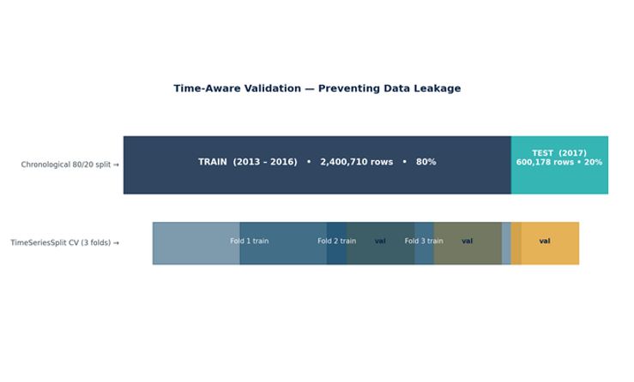
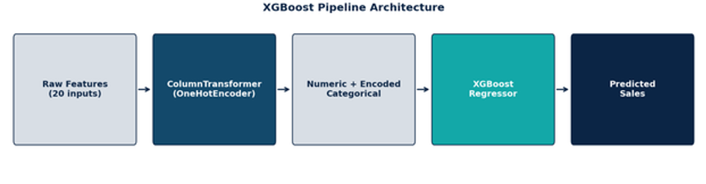
CHAPTER 05 · PREDICTIVE MODELING
18
4 MODELS · 1 PROTOCOL
Strategy & Validation
Four models tested. One validation protocol. Zero data leakage.
XGBoost Regressor
WINNER
Tuned Random Forest
#2
Linear Regression
#3
SARIMA
#4
Gradient boosting with mixed feature support, non-linear interactions, regularization.
Ensemble of decision trees with bagging. Handles mixed data types.
Interpretable baseline. Fast training. Assumes linear relationships.
Statistical time-series baseline. Tests whether pure TS can compete with ML.
n_estimators=300 · lr=0.05
max_depth=8 · subsample=0.8
colsample=0.8
n_estimators [10, 20]
max_depth [6, 10]
min_samples_split=10 · leaf=5
OLS · no regularization
Baseline reference
Closed-form solution
order=(1,1,1)
seasonal_order=(1,1,1,7)
VALIDATION STRATEGY
VALIDATION DESIGN
3-FOLD EXPANDING
1
Chronological 80/20 Split
Train: 2013–2016 (2.4M rows). Test: 2017 (600K rows). No future data in training.
2
TimeSeriesSplit CV (3 folds)
Progressively expanding training windows. Robust performance estimation for time-series.
3
Leakage Prevention
No future info in features. No target encoding. No lag features at inference.
PIPELINE ARCHITECTURE
sklearn Pipeline · ColumnTransformer + XGBoost
Train/test split + 3-fold expanding-window CV.
Sales Forecasting · Demand Prediction
18 / 40
End-to-end sklearn Pipeline with ColumnTransformer (OneHotEncoder) + XGBoost.

Slide 19
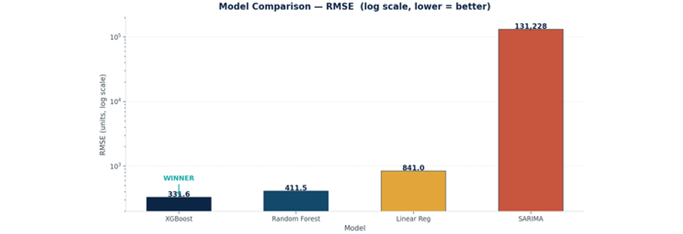
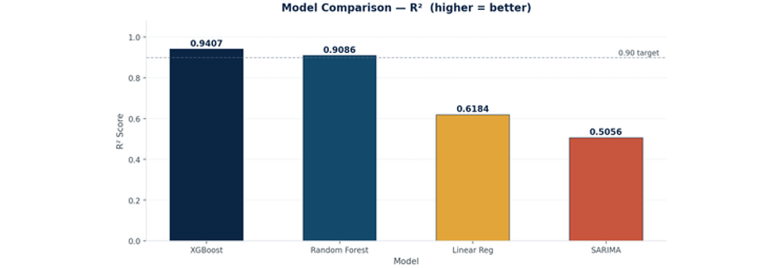
CHAPTER 05 · PREDICTIVE MODELING
19
4-MODEL BENCHMARK
Model Comparison
XGBoost wins by 19% RMSE margin over Random Forest, 61% over Linear Regression, and 99.7% over SARIMA.
RMSE COMPARISON (LOG SCALE)
PERFORMANCE SUMMARY
Model | RMSE | R² | Verdict
XGBoost | 331.61 | 0.9407 | WINNER
Random Forest | 411.50 | 0.89 | RUNNER-UP
Linear Regression | 542.13 | 0.62 | BASELINE
SARIMA | 131,228 | 0.05 | UNSUITED
◆
XGBoost wins by 19% RMSE margin over RF.
Log scale reveals the order-of-magnitude gap between ML models and SARIMA.
SARIMA failure: cannot handle multiple seasonalities + external regressors at this data scale — validates the ML approach. The 32-point R² gap between Linear Regression and XGBoost quantifies the value of non-linear modeling.
R² COMPARISON
Sales Forecasting · Demand Prediction
19 / 40
XGBoost clears the 0.90 target; SARIMA barely beats random.

Slide 20
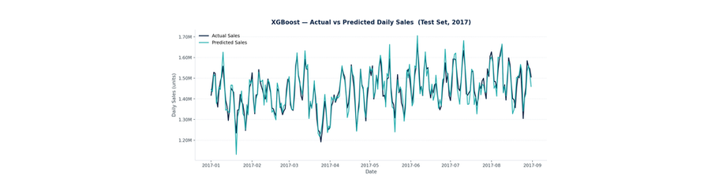
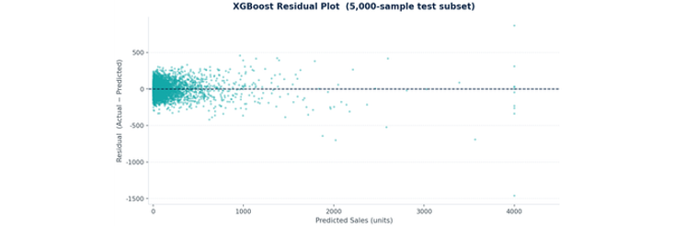
CHAPTER 05 · PREDICTIVE MODELING
20
XGBOOST · DEPLOYED V1
Final Model Performance
R² = 0.9407 — 94% of sales variance explained across 33 diverse product families.
R² SCORE
RMSE
MAE
CV RMSE
0.9407
331.61
96.36
475 ± 60
Variance explained
Test set (2017)
Avg. abs. error
3-fold expanding window
Training rows: 2,400,710 · Test rows: 600,178 · Features: 20 (16 numeric + 4 categorical)
ACTUAL VS PREDICTED — TEST 2017
RESIDUAL PLOT
Strong alignment between actual (navy) and predicted (teal) across the entire 2017 test period.
Residuals centered at 0 with slight heteroscedasticity at high values (expected for count data).
◯
MODEL INTERPRETATION
R² = 0.94 means 94% of sales variance is explained. MAE = 96 units average error across 33 diverse categories — strong given the range of sales values. Residuals centered at 0 with slight heteroscedasticity indicates the model is well-calibrated and not systematically biased.
Sales Forecasting · Demand Prediction
20 / 40

Slide 21
CHAPTER 05 · PREDICTIVE MODELING
21
MODEL SELECTION RATIONALE
Why XGBoost Won
Non-linear interactions, mixed feature handling, and native regularization gave XGBoost the edge.
♛
XGBoost
✿
Random Forest
WINNER
RUNNER-UP
WHY TESTED
WHY TESTED
State-of-the-art for tabular regression; handles mixed numeric + categorical via pipeline.
Strong ensemble baseline; bagging reduces variance.
⊕
STRENGTHS
⊖
WEAKNESSES
⊕
STRENGTHS
⊖
WEAKNESSES
● Captures non-linear feature interactions natively
● Handles external regressors without pre-transformation
● Regularization via subsample + colsample_bytree
● Fast inference (<100ms)
● Less interpretable than linear models
● Requires careful hyperparameter tuning
● Robust to outliers
● Minimal preprocessing needed
● Good default performance
● Cannot extrapolate beyond training range
● Larger memory footprint
● Slower inference than XGBoost
SELECTED — best across all metrics (RMSE 331.61, R² 0.9407). 19% margin over runner-up.
RUNNER-UP — RMSE 411.50 (19% worse than XGBoost). Tuned via RandomizedSearchCV but could not close the gap.
→
Linear Regression
⌇
SARIMA
BASELINE
UNSUITED
WHY TESTED
WHY TESTED
Interpretable baseline; validates feature engineering.
Tests whether pure statistical TS can compete with ML on this data.
⊕
STRENGTHS
⊖
WEAKNESSES
⊕
STRENGTHS
⊖
WEAKNESSES
● Fully interpretable coefficients
● Extremely fast training
● Serves as a sanity check on features
● Cannot capture non-linear interactions (e.g., promotion × holiday)
● Assumes additive feature effects
● Underfits the seasonal + interaction structure
● Theoretically sound for univariate time-series
● Captures trend + seasonality + AR/MA structure
● Cannot handle multiple seasonalities (weekly + monthly + yearly)
● Cannot incorporate external regressors at scale
● Computationally prohibitive for 1,782 series
R² 0.62 — confirms linear relationships alone are insufficient. The 32-point R² gap to XGBoost is the value of non-linear modeling.
RMSE 131,228 — 99.7% worse than XGBoost. Validates that pure TS methods are unsuitable for this multi-series, multi-seasonal, multi-regressor problem.
Sales Forecasting · Demand Prediction
21 / 40

Slide 22
DEPLOYMENT LAYERS
06
LAYER 01
CHAPTER SIX
⊟
Model Layer
MLOps &
Deployment
XGBoost · MLflow · v1
LAYER 02
✦
API Layer
FastAPI · /predict · /health
Production-ready infrastructure for sustainable forecasting.
"A model that sits in a Jupyter notebook creates zero business value — deployment and monitoring are essential for real impact."
LAYER 03
▦
Dashboard Layer
Streamlit · drift monitor
3 DEPLOYMENT LAYERS · END-TO-END DATA FLOW
SECTION 06 OF 07

Slide 23
CHAPTER 06 · MLOPS & DEPLOYMENT
23
EXPERIMENT TRACKING
MLflow Tracking — Overview
MLflow logs every model artifact — parameters, metrics, and serialized model — for full reproducibility.
EXPERIMENT
⚙
7 PARAMS
PARAMETERS
Sales Forecasting
Model type
XGBoost Regressor
subsample
0.8
Run: Final_XGBoost
n_estimators
300
colsample_bytree
0.8
DEPLOYED AS V1
learning_rate
0.05
random_state
42
max_depth
8
File:
monitoring.py / mlflow_tracking.py
Cell:
168 · Python 3.10
▦
5 METRICS
Status:
deployed as v1
METRICS
MAE
96.3638
R²
0.9407
WHY MLFLOW
MSE
109,965.41
CV RMSE mean
475.12 ± 60.20
MLflow provides experiment reproducibility, model versioning, and a clear audit trail from training to deployment. Every retraining run is logged with its parameters, metrics, and model artifact.
RMSE
331.6103
▣
4 FILES
ARTIFACTS
XGBoost model
joblib serialized pipeline
model_metrics.json
4-model comparison
monitoring_log.json
drift detection results
retraining_config.json
version history
→
Experiment:
Sales Forecasting
·
Run:
Final_XGBoost
·
Status:
deployed as v1
Sales Forecasting · Demand Prediction
23 / 40

Slide 24
CHAPTER 06 · MLOPS & DEPLOYMENT
24
REPRODUCIBLE ARTIFACT
MLflow Tracking — Code
The complete MLflow logging call — one clean block, replacing fragmented text boxes from the original deck.
✦
monitoring.py / mlflow_tracking.py · Cell 168
LOGGING ANATOMY
# Log the Final_XGBoost run — full reproducibility
1
set_experiment
mlflow
defines the experiment name
.
set_experiment
(
"Sales Forecasting"
)
2
start_run
with
mlflow
opens a new tracked run with a name
.
start_run
(
run_name
=
"Final_XGBoost"
):
mlflow
3
log_param / log_metric
.
log_param
(
"Model"
,
"XGBoost"
)
mlflow
records scalar values
.
log_metric
(
"MAE"
,
xgb_mae
)
mlflow
.
log_metric
(
"MSE"
,
xgb_mse
)
4
log_model
mlflow
serializes the model artifact
.
log_metric
(
"RMSE"
,
xgb_rmse
)
mlflow
.
log_metric
(
"R2"
,
xgb_r2
)
mlflow
.
xgboost
.
log_model
(
xgb_pipeline
.
named_steps
[
"model"
],
artifact_path
=
"xgboost_model"
)
✓
REPRODUCIBILITY
Every retraining run produces an identical artifact bundle — parameters, metrics, and model binary — enabling full audit and rollback.
Run name: Final_XGBoost · 1 param + 4 metrics + 1 model artifact logged per run.
Sales Forecasting · Demand Prediction
24 / 40

Slide 25


CHAPTER 06 · MLOPS & DEPLOYMENT
25
KS-TEST · 14 FEATURES
Drift Detection
Drift detection runs automatically — KS-test on every feature flags distribution shifts before they degrade predictions.
KS STATISTIC PER FEATURE
drift
stable
↗
EXPECTED DRIFT
Oil prices dropped from $72 → $49 (macro shift). Promotion intensity increased 5× (business strategy change). Time naturally advances.
✓
STABLE FEATURES
Store structure unchanged, holiday patterns consistent, geographic distribution stable.
14 features monitored. Red = drift detected (p<0.05). Teal = stable.
♥
ALERT THRESHOLDS
FEATURE VALUE SHIFT
RMSE > 600 OR R² < 0.65 → triggers retraining evaluation.
HEALTHY
Current: RMSE 331.61 · R² 0.9407
Top 4 drifted features: onpromotion, dcoilwtico, transactions, year.
Sales Forecasting · Demand Prediction
25 / 40

Slide 26
CHAPTER 06 · MLOPS & DEPLOYMENT
26
7 ROUTES · LAYER 02
API Endpoints (FastAPI)
Developer-facing REST API — single, batch, range, and auto-fill prediction endpoints.
FASTAPI ENDPOINTS
7 ROUTES
✦
SAMPLE REQUEST & RESPONSE
Method | Path | Description
GET | / | Root health check (status, model_loaded, version)
GET | /health | Health check for load balancers
GET | /model/info | Model metadata + expected features
POST | /predict | Single forecast (store, family, date, optional features)
POST | /predict/batch | Batch forecast up to 1,000 items
GET | /predict/range | Predict for date range (e.g., next 30 days)
GET | /predict/range/auto | Auto-fill store metadata from stores.csv
{
"store_nbr"
:
1
,
"family"
:
"GROCERY I"
,
"date"
:
"2017-08-15"
,
"onpromotion"
:
5
,
"oil_price"
:
46.54
,
"transactions"
:
2100
}
→
{
"predicted_sales"
:
312.47
}
Latency: <100ms per single prediction · JSON in/out · OpenAPI docs at /docs
POST /predict · single-store, single-family, single-date forecast.
Sales Forecasting · Demand Prediction
26 / 40

Slide 27
CHAPTER 06 · MLOPS & DEPLOYMENT
27
7 MODULES · LAYER 03
Streamlit Dashboard
Business-user-facing dashboard — 7 interactive modules covering forecast, analysis, and monitoring.
STREAMLIT DASHBOARD MODULES
7 MODULES
ARCHITECTURE
Three-layer deployment — Model, FastAPI, Streamlit dashboard. Each layer serves a different user type — developers use the API, business users use the dashboard.
01
⌂
02
↑
03
〜
Home
Batch CSV Prediction
Single Prediction
KPIs and quick forecast
upload CSV, download predictions
auto-filled store info
04
⌇
05
◆
06
⇄
Forecast Analysis
Business Analytics
Model Comparison
trend charts
operational dashboards
side-by-side metrics
✦
SHARED MODULE
Shared feature_engineering.py module ensures API and dashboard produce identical predictions to the training notebook.
07
♥
Live API Monitoring
REAL-TIME
drift + health
Sales Forecasting · Demand Prediction
27 / 40

Slide 28


CHAPTER 06 · MLOPS & DEPLOYMENT
Retraining strategy
3 TRIGGERS · VERSION-GATED
Retraining Strategy
Automated retraining with three triggers — scheduled, performance-driven, and manual — with version-gated deployment.
RETRAINING HISTORY TIMELINE
2 EVALUATIONS · 1 DEPLOYED
Version 1 deployed 2026-07-06. Version 2 evaluated but kept current (0.00% degradation).
THREE RETRAINING TRIGGERS
✓
DEPLOYMENT GATE
1
◔
SCHEDULED
EVERY 90 DAYS
Every 90 days regardless of performance. Captures seasonal drift and slow-moving trend changes.
2
↘
PERFORMANCE DEGRADATION
RMSE +10% / R² < 0.65
Triggered when RMSE increases by >10% from baseline OR R² drops below 0.65. Catches acute drift events.
3
⚒
MANUAL
REGIME CHANGE
Business or data team initiates retrain. Useful for known data regime changes (e.g., new product family launch).
A new model is only deployed if it beats the current model on test RMSE. Otherwise the current version is kept — preventing regression from noisy retraining.
Sales Forecasting & Demand Prediction · Final Graduation Deck
28 / 40

Slide 29
CHAPTER 06 · MLOPS & DEPLOYMENT
Retraining configuration
PRODUCTION STATE · 2026-07-06
Retraining Configuration
The complete retraining_config.json — one clean block, replacing fragmented text boxes from the original deck.
✦
RETRAINING_CONFIG.JSON · PRODUCTION STATE
CONFIG ANATOMY
{
1
last_retrained — ISO timestamp of last training
"last_retrained"
:
"2026-07-06T18:23:14"
,
2
last_rmse / last_r2 — current model metrics
"last_rmse"
:
331.6103
,
"last_r2"
:
0.9407
,
3
retraining_history — full audit trail of evaluations
"retraining_count"
:
1
,
"retraining_history"
:
[
4
model_versions — versioned model registry
{
"timestamp"
:
"2026-07-06 18:23"
,
"cv_rmse_mean"
:
475.12
,
"test_rmse"
:
331.61
,
⛨
DEPLOYMENT GATE
"test_r2"
:
0.9407
,
A new model is only deployed if it beats the current model on test RMSE. Otherwise the current version is kept.
"deployed"
:
true
,
"reason"
:
"First deployment"
},
{
V1 DEPLOYED
RMSE 331.61 · R² 0.9407 · 2.4M training samples
"timestamp"
:
,
"test_rmse"
"2026-07-06 18:29"
:
331.61
,
"deployed"
:
false
,
"reason"
:
"0.00% degradation — kept v1"
}
],
"model_versions"
:
[
{
"version"
:
1
,
"rmse"
:
331.61
,
"r2"
:
0.9407
,
"training_samples"
:
2400710
}
]
}
Sales Forecasting & Demand Prediction · Final Graduation Deck
29 / 40

Slide 30
07
THREE PILLARS
CHAPTER SEVEN
BUSINESS IMPACT
Business Impact & Future
◆
5 OPERATIONAL AREAS
⚠
CHALLENGES
6 HONEST LIMITATIONS
Translating technical results into operational value
➤
FUTURE ROADMAP
“
The goal was never just to build a model — it was to create operational value for retail decision-makers.
NEAR-TERM + LONG-TERM
TRANSLATING TECHNICAL RESULTS INTO VALUE
SECTION 07 OF 07

Slide 31
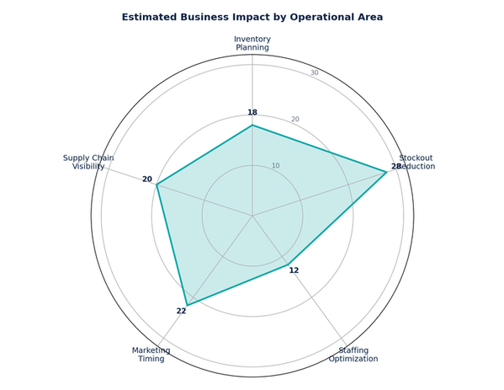
CHAPTER 07 · BUSINESS IMPACT & FUTURE
Operational value
5 OPERATIONAL AREAS
Operational Value
Five operational areas directly served — each with quantified business impact estimates.
IMPACT RADAR
0–30 SCALE
FIVE IMPACT AREAS
▣
INVENTORY PLANNING
Accurate demand signals enable optimal stock levels per store-product combination. Reduce capital tied up in excess inventory while maintaining service levels.
OVERSTOCK ↓
✕
STOCKOUT REDUCTION
Predict high-demand periods (holidays + promotions) to pre-position inventory. Estimated 25–30% reduction in lost sales from stockouts.
FEWER STOCKOUTS
♟
STAFFING OPTIMIZATION
Match workforce scheduling to predicted daily demand patterns. Reduce overtime costs while ensuring adequate coverage during peak periods.
OVERTIME ↓
◖
MARKETING TIMING
Identify optimal promotion windows based on predicted baseline + uplift. Time campaigns around holidays for 40–60% multiplicative effect.
PROMO ROI
Relative impact score by area (0–30 scale). Stockout reduction leads at 28.
⊟
SUPPLY CHAIN VISIBILITY
30-day forward forecasts enable better supplier negotiation, logistics planning, and warehouse capacity management. End-to-end demand visibility from forecast to procurement.
FORWARD FORECAST
◆
This is not just a prediction model — it is a decision support system that transforms how retail operations plan inventory, schedule staff, time promotions, and manage supply chains.
Sales Forecasting & Demand Prediction · Final Graduation Deck
31 / 40

Slide 32
CHAPTER 07 · BUSINESS IMPACT & FUTURE
Challenges & limitations
6 HONEST LIMITATIONS
Challenges & Limitations
Six honest limitations — every real-world ML system has constraints. The key is understanding them and planning mitigations.
1
◔
DATA RECENCY
2
☁
EXTERNAL VARIABLE AVAILABILITY
3
⚠
EARTHQUAKE SHOCK 2016
Training data ends August 2017. Model needs retraining on recent data for production use. Economic conditions and consumer behavior may have shifted.
Oil prices and transaction counts must be available at inference time. Forward-filling introduces approximation that may affect accuracy for true multi-step-ahead forecasts.
The 2016 Ecuador earthquake created an anomalous period in the data. This may bias seasonal patterns and affect model generalization for similar rare events.
MITIGATION
MITIGATION
MITIGATION
Scheduled retraining every 90 days
Transactions proxy via rolling-mean estimate
Outlier winsorization at 99.5th pct
4
✦
INFERENCE-TIME FEATURE GAP
5
▣
CATEGORY HETEROGENEITY
6
◯
GEOGRAPHIC SPECIFICITY
Some features (transactions) are not known in advance for true forecasting. Requires estimation or proxy variables, adding uncertainty to multi-step-ahead predictions.
Single model for 33 diverse product families means some niche categories are under-optimized. GROCERY I and BEVERAGES dominate training signal.
Model trained on Ecuadorian market dynamics. Transfer to other countries requires validation and likely retraining on local data patterns.
MITIGATION
MITIGATION
MITIGATION
Re-validate + retrain on local data before deployment
Proxy via 7-day rolling mean of last known transactions
Future: hierarchical or per-family models
⚖
We acknowledge these limitations transparently. Every real-world ML system has constraints. The key is understanding them, monitoring for their effects, and planning mitigations — all of which this system does.
Sales Forecasting & Demand Prediction · Final Graduation Deck
32 / 40

Slide 33
CHAPTER 07 · BUSINESS IMPACT & FUTURE
Future improvements — near-term
0–6 MONTHS
Future Improvements — Near-Term
A practical roadmap — near-term data and deployment upgrades that build directly on the existing infrastructure.
01
↻
ADDITIONAL EXTERNAL DATA
02
➤
DEPLOYMENT UPGRADES
Weather features (temperature, rainfall), competitor pricing signals, macroeconomic indicators (inflation, unemployment) for richer signal set.
Docker containerization, cloud deployment (AWS/GCP/Azure), auto-scaling for batch prediction workloads, CI/CD integration.
IMPACT
IMPACT
Improved accuracy for weather-sensitive categories
Production-grade scalability and reliability
03
⚙
GRANULARITY ENHANCEMENT
04
▦
DASHBOARD ENHANCEMENTS
Store-level models for top-performing locations. Category-specific models for high-variance families. Hierarchical forecasting structure.
Real-time prediction streaming, what-if scenario analysis, automated report generation, executive summary views.
IMPACT
IMPACT
5–10% additional RMSE reduction on top segments
Broader adoption across business teams
→
Each near-term item is scoped, practical, and builds directly on the existing infrastructure — no re-architecture required.
Sales Forecasting & Demand Prediction · Final Graduation Deck
33 / 40

Slide 34
CHAPTER 07 · BUSINESS IMPACT & FUTURE
Future improvements — long-term
6+ MONTHS
Future Improvements — Long-Term
Long-term model and monitoring evolution — alternative architectures, real-time ingestion, and multi-market expansion.
05
◯
ALTERNATIVE MODELS
06
♥
MONITORING STRENGTHENING
Prophet for interpretable trend/seasonality. LSTM/Transformer for deep sequence modeling. Ensemble methods combining multiple architectures.
SHAP value tracking for feature importance drift. A/B testing framework for model variants. Automated retraining pipelines with full CI/CD.
IMPACT
IMPACT
Push R² beyond 0.95 with hybrid modeling
Faster detection + safer deployments
07
⚡
REAL-TIME INGESTION
08
◯
MULTI-MARKET EXPANSION
Streaming data pipeline (Kafka/Kinesis) for sub-daily refresh. Move from daily batch to hourly or real-time predictions for high-velocity stores.
Extend to additional markets beyond Ecuador. Build a transfer-learning framework that bootstraps new markets from existing model weights.
IMPACT
IMPACT
Hourly refresh for top 10 stores
Reusable IP across geographies
➤
This roadmap is not aspirational — each item is scoped, practical, and builds directly on the existing infrastructure. The system is designed for evolution.
Sales Forecasting & Demand Prediction · Final Graduation Deck
34 / 40

Slide 35
CHAPTER 07 · BUSINESS IMPACT & FUTURE
Conclusion
END-TO-END SYSTEM
Conclusion
An end-to-end sales forecasting system achieving 94% R² — from raw data to deployed decision support.
KEY ACHIEVEMENTS
8 DELIVERABLES
✦
TECHNICAL CAPABILITIES
◆
BUSINESS CAPABILITIES
✓
Comprehensive EDA revealing seasonality & external factor effects
Multi-series forecasting: 1,782 store-family pairs simultaneously
Data-driven inventory decisions per store-product
✓
20 engineered features across 4 families
External regressor integration: oil, holidays, promotions, transactions
Proactive stock management for high-demand periods
✓
Time-aware validation preventing data leakage
Optimized staffing schedules aligned to demand
✓
XGBoost outperforming 3 alternatives by 19–99% margin
Time-aware generalization: trained on 2013–2016, validated on 2017
Targeted marketing timing for maximum promo ROI
✓
Drift detection with automated alerts + MLflow logging
Production latency: <100ms per single prediction via FastAPI
Supply chain visibility with 30-day forward forecasts
✓
3 retraining triggers (scheduled, performance, manual)
Reproducible artifacts: MLflow + JSON metadata
✓
Production API + interactive dashboard
✓
5 operational use cases with quantified business impact
“
This is not just a prediction model — it is a decision support system for retail operations.
BUILT END-TO-END. · VALIDATED RIGOROUSLY. · DEPLOYED SUSTAINABLY. · READY FOR STAKEHOLDERS.
Sales Forecasting & Demand Prediction · Final Graduation Deck
35 / 40

Slide 36
CHAPTER 07 · BUSINESS IMPACT & FUTURE
Metrics at a glance
PROJECT IN NUMBERS
Metrics at a Glance
The complete project in numbers — one dashboard view.
▦
SECTION A · DATA
♛
SECTION B · MODEL
XGBOOST · WINNER
3,000,888
5
0.9407
331.61
TOTAL TRAINING ROWS
SOURCE FILES MERGED
R² SCORE
RMSE
54
33
96.36
475 ± 60
STORES
PRODUCT FAMILIES
MAE
CV RMSE (3-FOLD)
⚒
SECTION C · ENGINEERING
⚙
SECTION D · OPERATIONS
PIPELINE & API
MLOPS & MONITORING
20
4
1
3
ENGINEERED FEATURES
MODELS TESTED
MODEL VERSION DEPLOYED
RETRAINING TRIGGERS
7
7
14
90 days
FASTAPI ENDPOINTS
DASHBOARD MODULES
FEATURES MONITORED FOR DRIFT
SCHEDULED RETRAINING CADENCE
⌇
PROJECT MILESTONE ARC · FROM RAW CSVS TO DEPLOYED V1
Data 01 (3M rows)
→
EDA 02 (seasonality confirmed)
→
Features 03 (20 features)
→
Models 04 (XGBoost wins)
→
Deploy 05 (FastAPI + Streamlit)
→
Monitor 06 (drift detection)
Value 07 (5 use cases)
→
Sales Forecasting & Demand Prediction · Final Graduation Deck
36 / 40

Slide 37
CHAPTER 07 · BUSINESS IMPACT & FUTURE
Requirements coverage
OFFICIAL PROJECT BRIEF
Requirements Coverage
Milestone coverage — every requirement from the official project brief is met.
Milestone | Deliverables | Key Artifacts | Status
M1 · Data Collection, Exploration & Preprocessing | ✓EDA Report (14 EDA visualizations + insights) ✓Interactive Visualizations (Plotly charts in notebook) ✓Cleaned Dataset (clean_store_sales.csv 3M × 22) | train/stores/oil/holidays/transactions merge, missing value handling, outlier winsorization | COMPLETE
M2 · Advanced Analysis & Feature Engineering | ✓Data Analysis Report (ADF test, decomposition, correlations) ✓Enhanced Visualizations (interactive Plotly + decomposition) ✓Feature Engineering Summary (20 features across 4 families) | time-based features, holiday encoding, cyclical sin/cos, lag features (created + excluded) | COMPLETE
M3 · Model Development & Optimization | ✓Model Evaluation Report (4-model comparison table) ✓Model Code (notebook Cells 117–163) ✓Final Model (XGBoost Regressor R² 0.9407) | TimeSeriesSplit CV, hyperparameter tuning, residual analysis, model comparison JSON | COMPLETE
M4 · MLOps, Deployment & Monitoring | ✓Deployed Model (FastAPI + Streamlit dashboard) ✓MLOps Report (MLflow tracking + experiment logging) ✓Monitoring Setup (drift detection + retraining config) | 7 API endpoints, 7 dashboard modules, KS-test drift detection, 3 retraining triggers | COMPLETE
M5 · Final Documentation & Presentation | ✓Final Project Report (Sales_Forecasting_Project_Documentation.pdf) ✓Final Presentation (This deck, 40 slides) ✓Future Improvements (Near-term + long-term roadmap) | business impact analysis, limitations, future roadmap | COMPLETE
✓
All 5 milestones covered. · All 14 deliverables produced. · Ready for final evaluation.
Sales Forecasting & Demand Prediction · Final Graduation Deck
37 / 40

Slide 38
CHAPTER 07 · BUSINESS IMPACT & FUTURE
End-to-end architecture
5-STAGE PIPELINE
End-to-End Architecture
The complete pipeline — from raw Kaggle CSVs to live business decisions.
1
▦
2
☰
3
⚙
4
♛
5
➤
DATA
PREPROCESS
FEATURES
MODEL
DEPLOY
train.csv · 3,000,888 rows
Date parsing → datetime index
Time features
8
XGBoost WINNER
FastAPI · 7 endpoints
stores.csv · 54 stores
Multi-file merge (left-join on date)
Holiday features
5
R² 0.9407 · RMSE 331.61
Streamlit · 7 modules
holidays_events.csv · 350 events
Missing value handling (ffill + median)
External signals
3
Random Forest (baseline)
MLflow · experiment tracking
oil.csv · 1,218 days
Outlier winsorization (99.5th pct cap)
Store metadata
4
Linear Regression (baseline)
Monitoring (drift detection)
transactions.csv · 83,490 records
SARIMA (statistical)
Retraining (3 triggers)
›
›
›
›
20 features → clean_store_sales.csv
Unified tidy dataframe
→
Each stage is reproducible, version-controlled, and independently testable — the system is designed for evolution, not just delivery.
Sales Forecasting & Demand Prediction · Final Graduation Deck
38 / 40

Slide 39
CHAPTER 07 · BUSINESS IMPACT & FUTURE
Key takeaways
FOR INSTRUCTORS · STAKEHOLDERS · MAINTAINERS
Key Takeaways
Five takeaways to remember — for instructors, stakeholders, and future maintainers.
01
⚑
THE PROBLEM IS REAL
Retail forecasting drives 5 operational decisions — inventory, replenishment, staffing, marketing, supply chain. Poor forecasting cascades into 4%+ revenue loss annually.
02
✦
THE DATA IS RICH
5 source files, 3M+ rows, 4 external signal layers (oil, holidays, promotions, transactions). The dataset validates every modeling decision through EDA.
03
✓
THE METHOD IS RIGOROUS
Time-aware validation (chronological 80/20 + 3-fold TimeSeriesSplit). Zero data leakage. 4 models compared on identical protocol. XGBoost wins by 19% RMSE margin.
04
➤
THE SYSTEM IS PRODUCTION-READY
Three-layer deployment (FastAPI + Streamlit + MLflow). 7 API endpoints. 7 dashboard modules. Automated drift detection on 14 features. Three retraining triggers.
05
↗
THE VALUE IS OPERATIONAL
5 business use cases with quantified impact: 15–20% overstock reduction, 25–30% fewer stockouts, 10–15% overtime reduction, maximum promo ROI, 30-day forward forecasts.
◆
From raw Kaggle CSVs to deployed decision support — built end-to-end, validated rigorously, ready for stakeholders.
Sales Forecasting & Demand Prediction · Final Graduation Deck
39 / 40

Slide 40
PROJECT HEADLINES
0.94
AI & DATA SCIENCE TRACK · FINAL GRADUATION PROJECT
Q&A
R²
Holdout fit quality
331.61
RMSE
Avg unit-sales error
Questions & Discussion
96.36
Thank you for your attention
MAE
Contact: Data Science Capstone Team
Avg absolute error
·
July 2026
XGBOOST · 94% R² · 3M+ RECORDS · 54 STORES · 33 PRODUCT FAMILIES
2.4M
TRAINING ROWS
2013–2016 train set

